Slide 1

Topic: swiggy data analysis using ibm cognos service
Manay Rawal
20100BTCSDSI07277
Yash Raj Surana
20100BTCSDSI07302

Slide 2
content
Introduction on IBM Cognos
Dashboard
Report
Types of Reports
About swiggy
Story

Slide 3

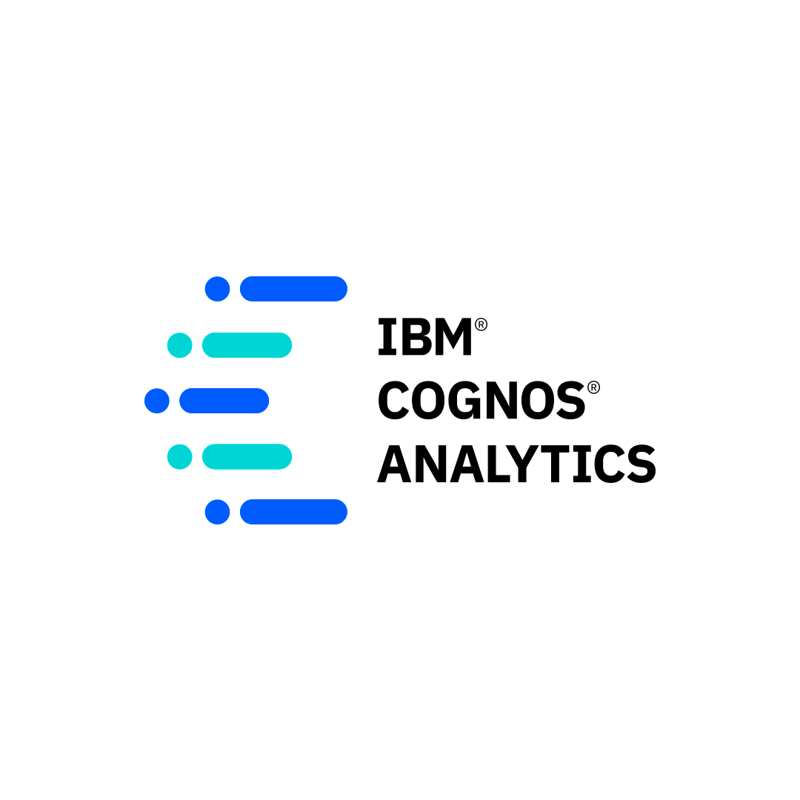
Introduction(what is IBM Cognos)
IBM Cognos is a web-based integrated business intelligence tool which is suited by IBM. Today cognos is one of the top business intelligence tool.
This software provides various features to perform data aggregation and create user-friendly detailed reports.

Slide 4
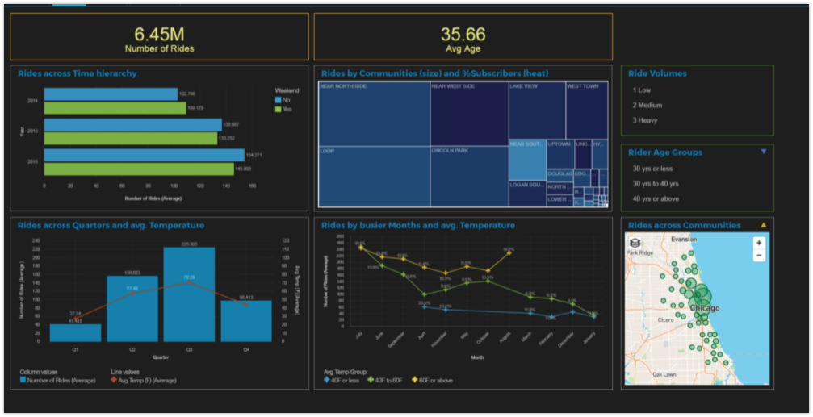
Dashboard
A dashboard helps you to monitor events or activities at a glance by providing key insights and analysis about your data on one or more pages or screens.

Slide 5
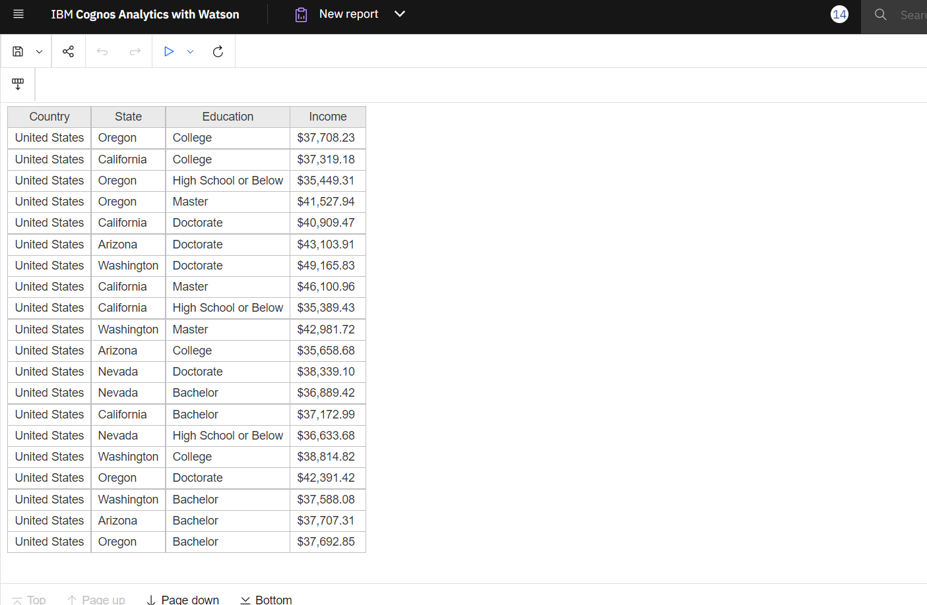
Report
Reporting is a web-based report authoring tool that professional report authors and developers use to build sophisticated, multiple-page, multiple-query reports against multiple databases.

Slide 6

SWIGGY

Slide 7

About the topic

Slide 8
Types of Reports
There are some types of Reports
1. List
2. Crosstab
3. Visualization

Slide 9
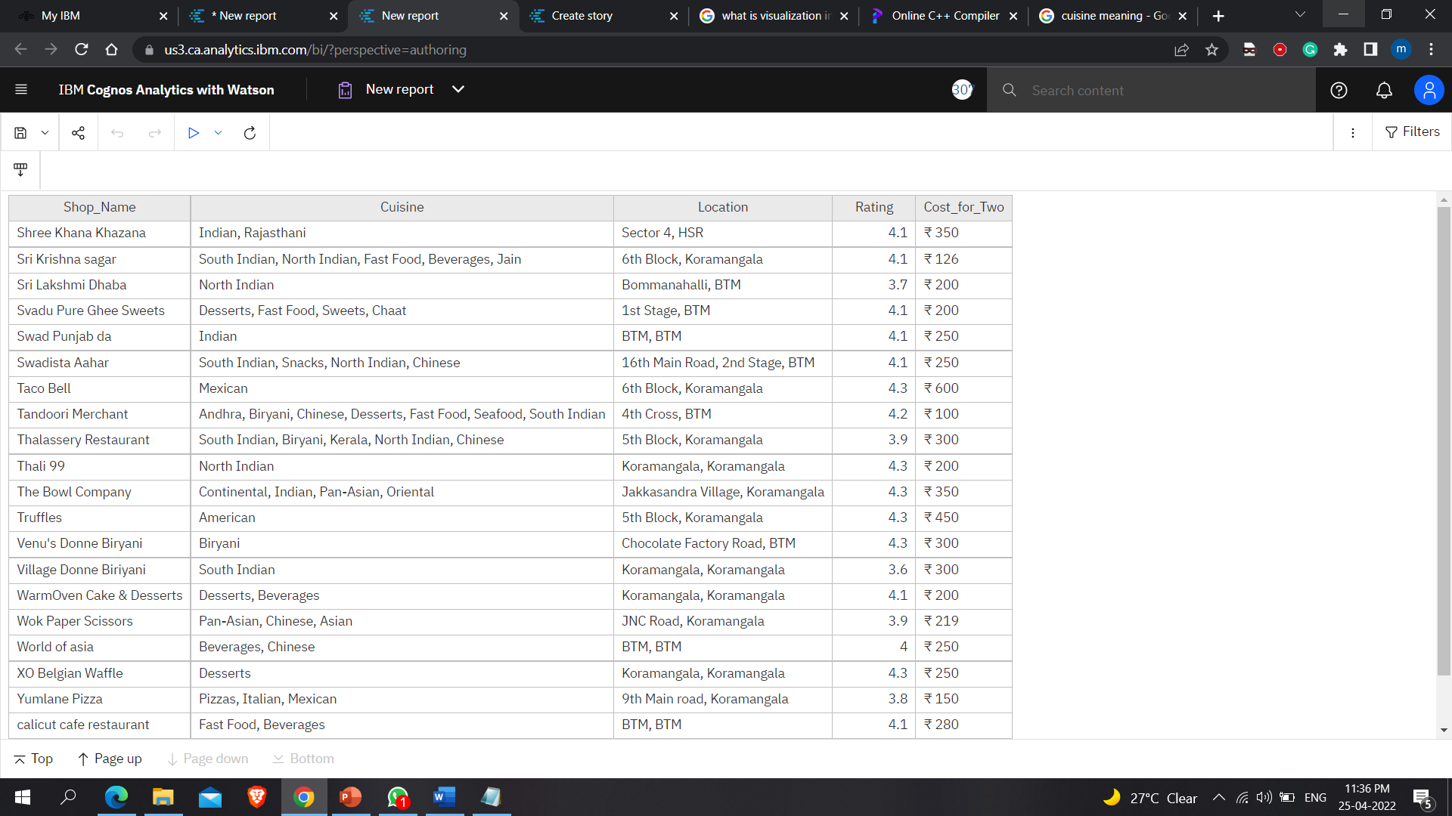
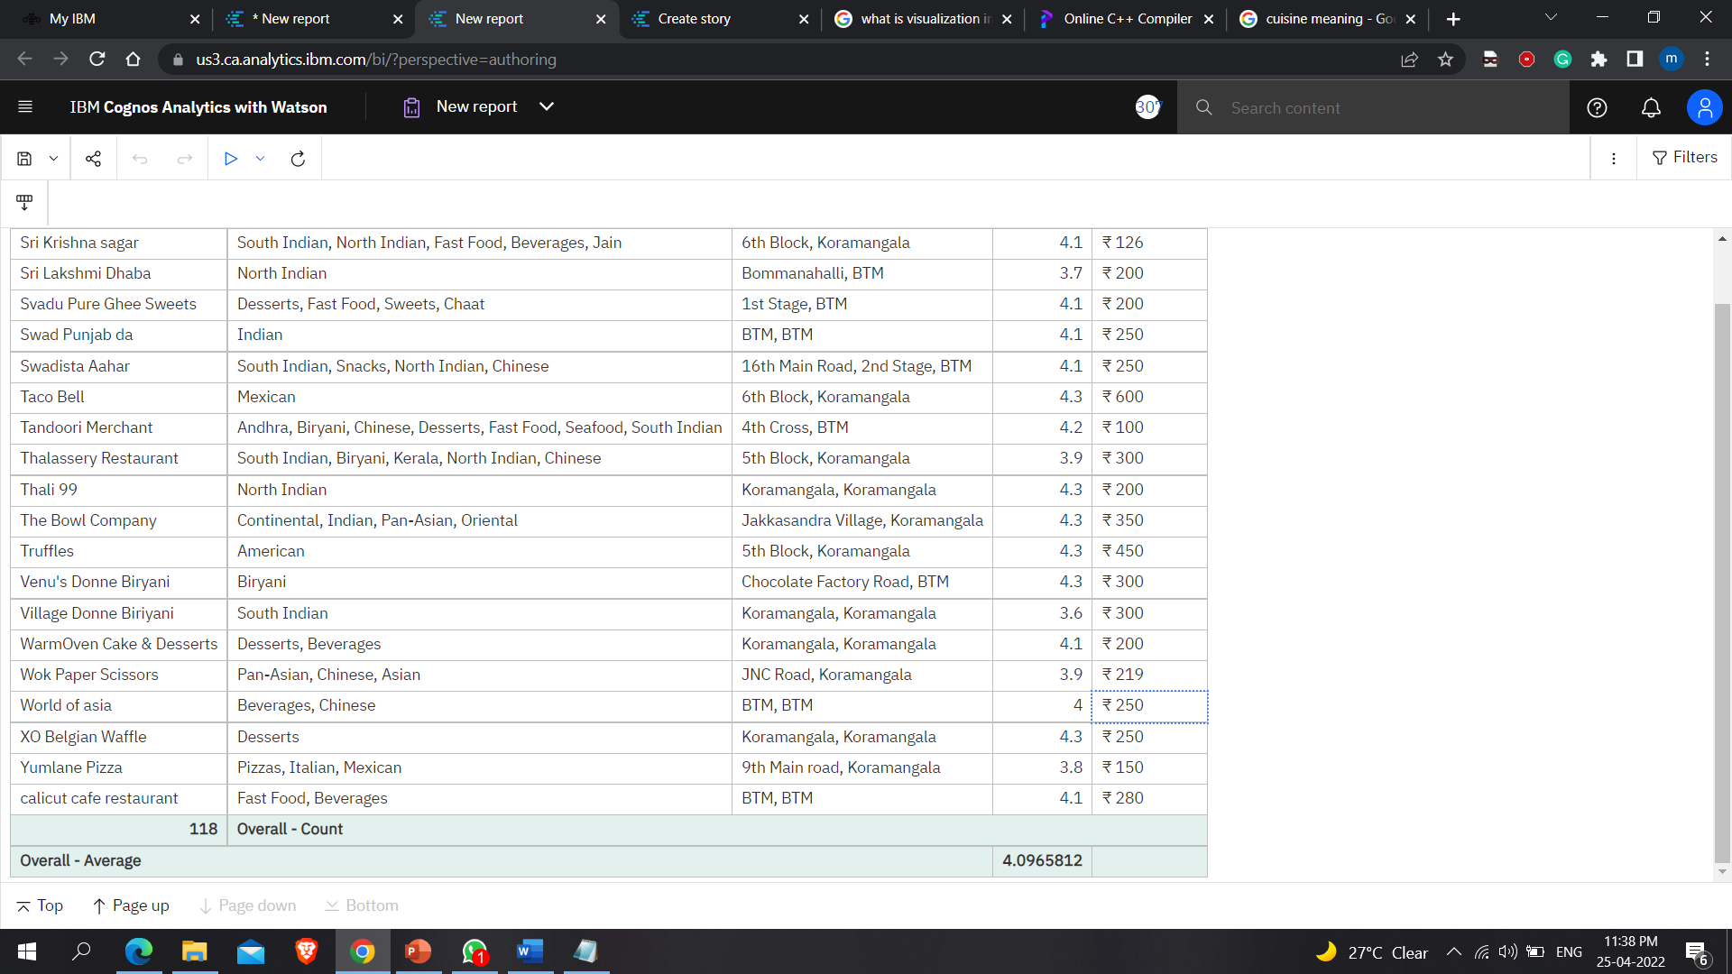
LIST
A list report shows data in rows and columns. You can apply a filter, summary, or calculation to manipulate the data that appears in the report.

Slide 10
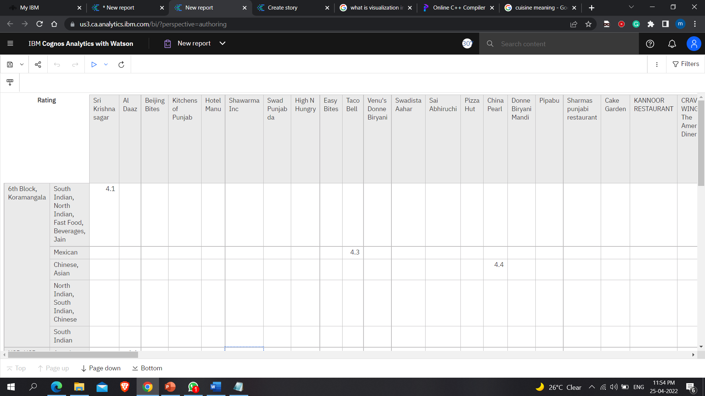
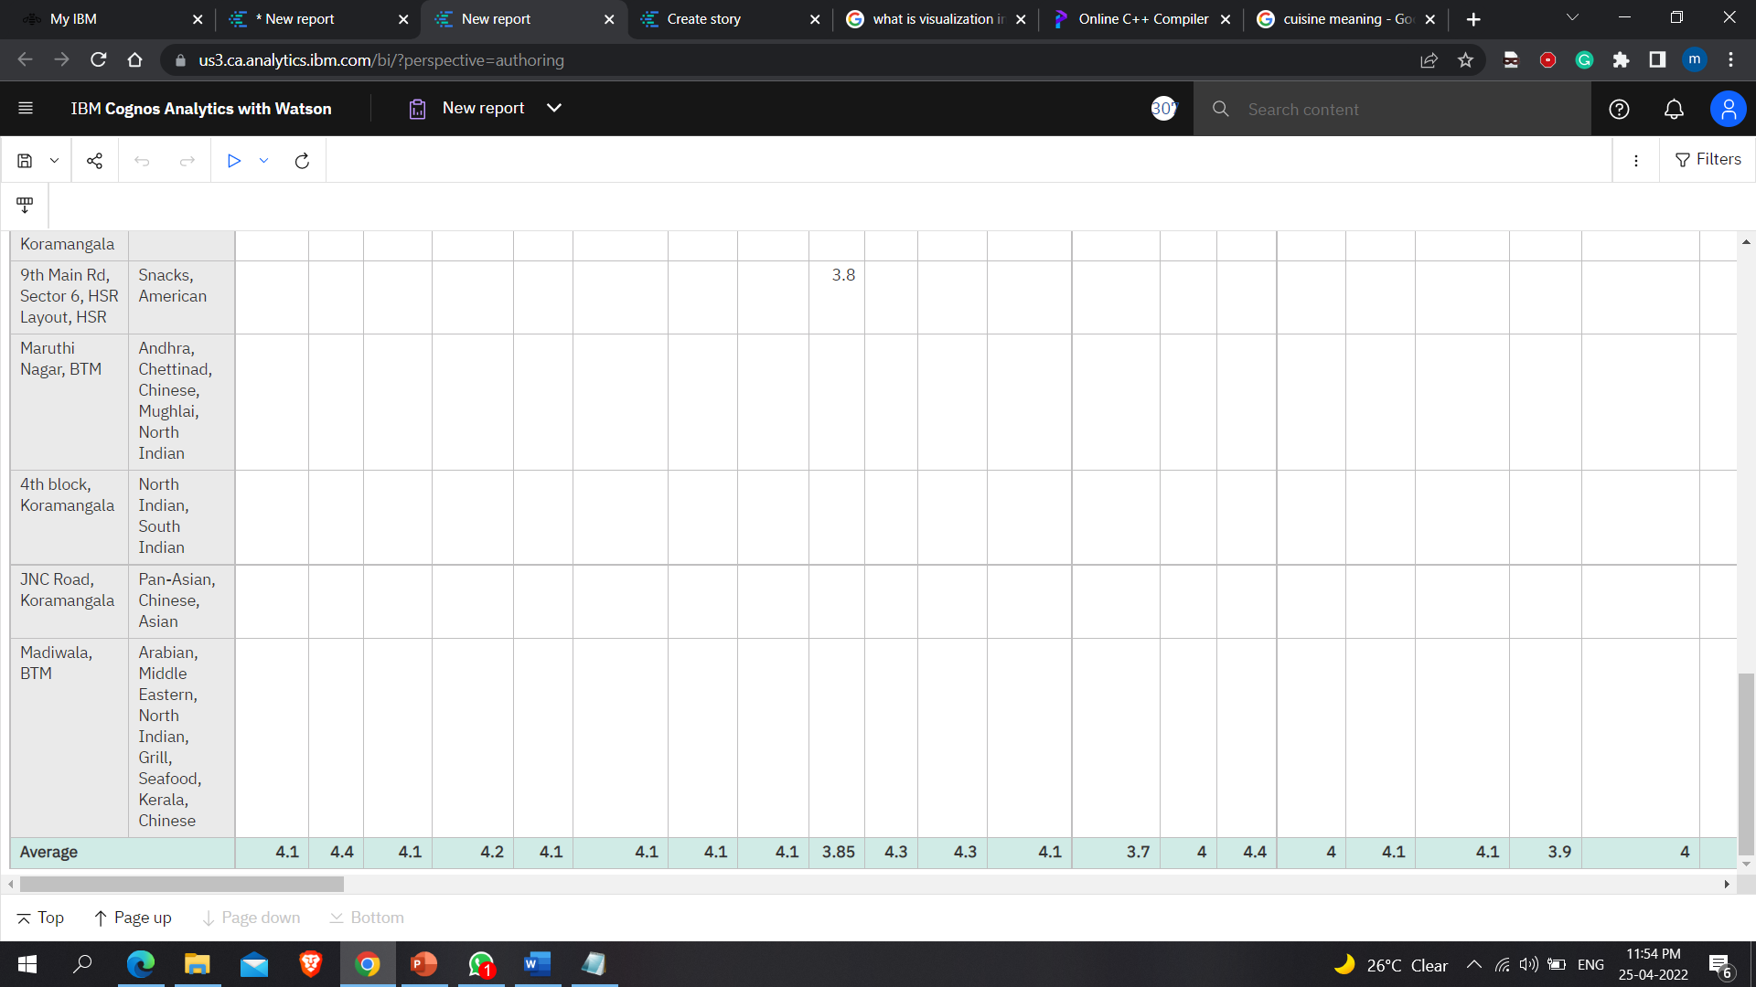
CROSSTAB
Use crosstab reports, also known as matrix reports, to show the relationships between three or more query items. Crosstab reports show data in rows and columns with information summarized at the intersection points.

Slide 11
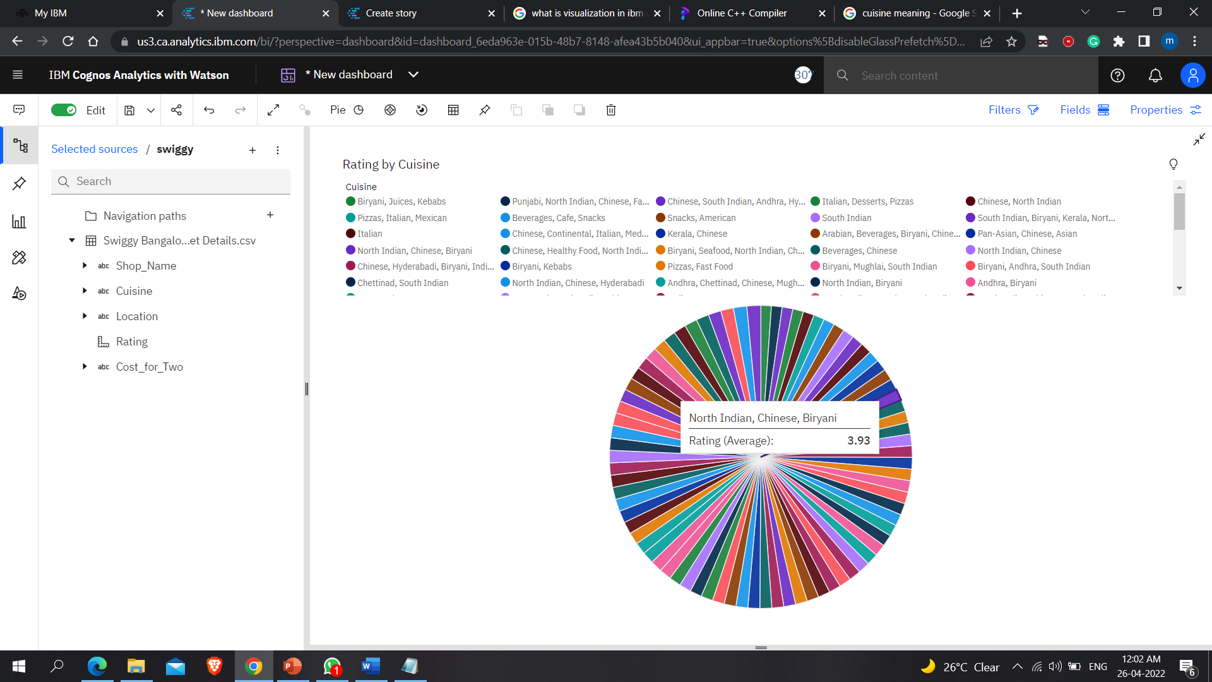
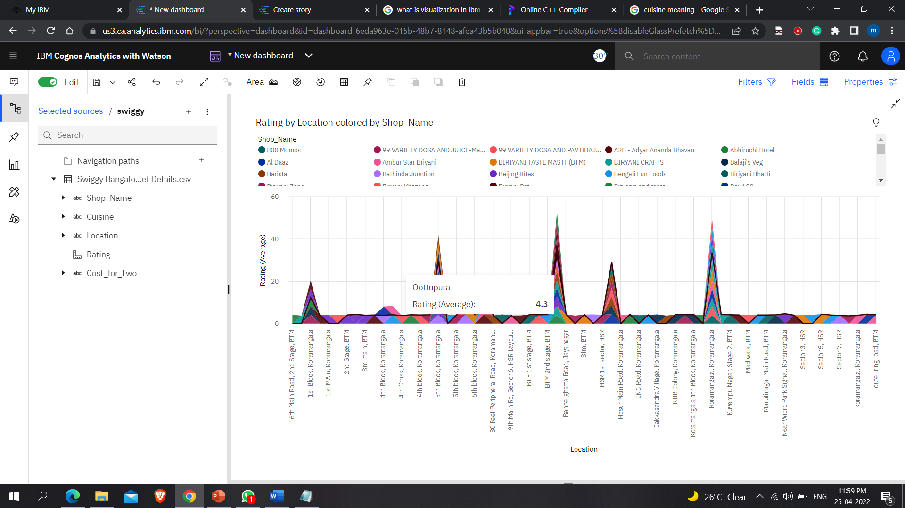
VISUALIZATION
Visualizations report help consumers to spot patterns and outliers and to understand data.
Use IBM Cognos Analytics visualization tools to incorporate diverse types of visualizations and greater interactivity into the IBM Cognos reports.

Slide 12
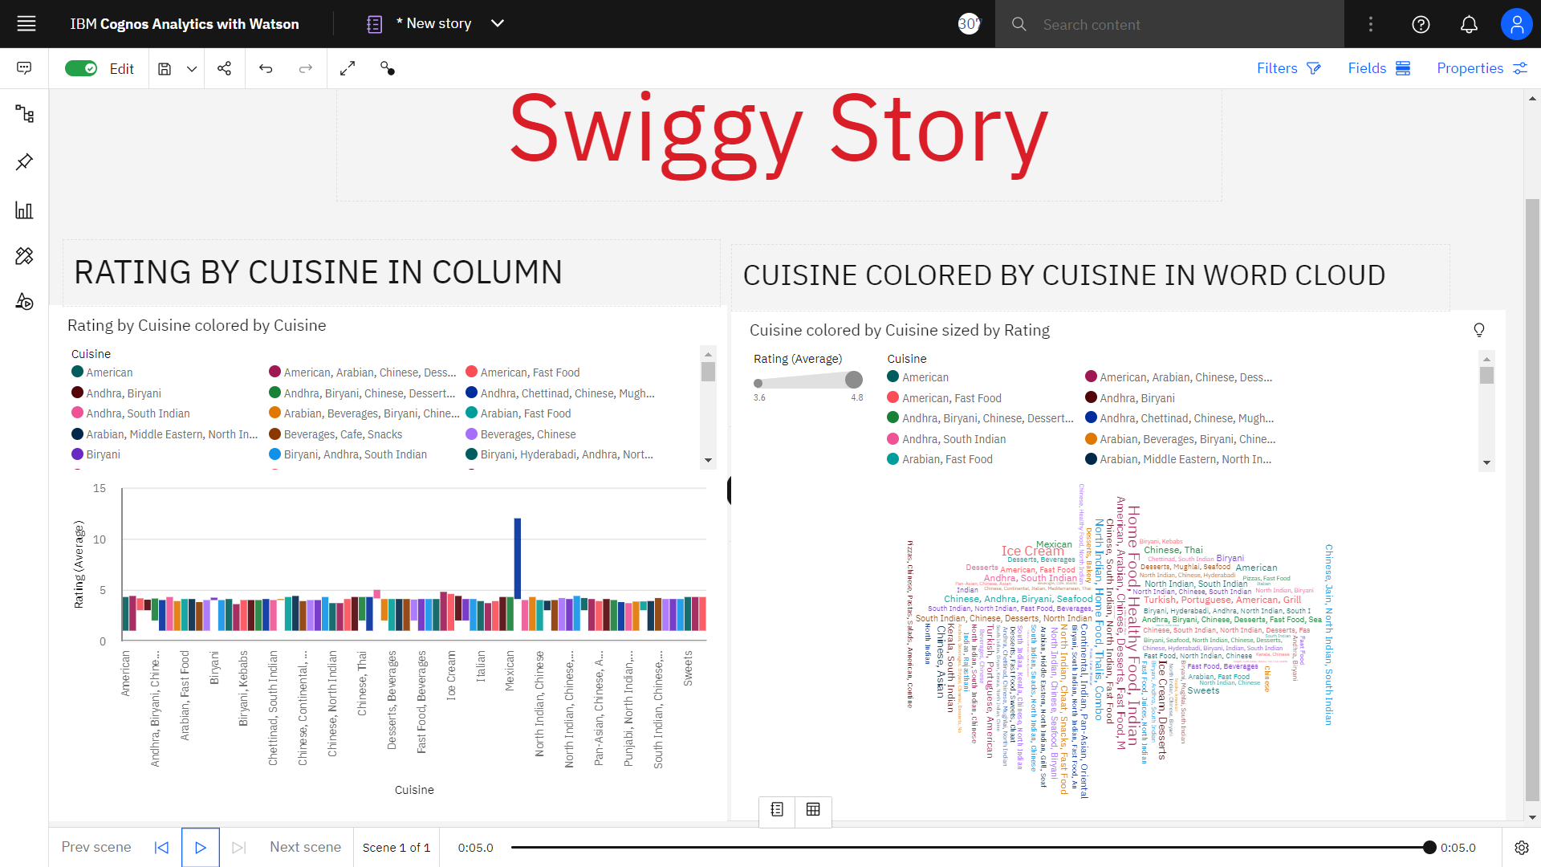
Story
A story is a type of view. A story is composed of a set of scenes that are displayed in sequence over time. Stories can be used to provide your data with a visual narrative.

Slide 13
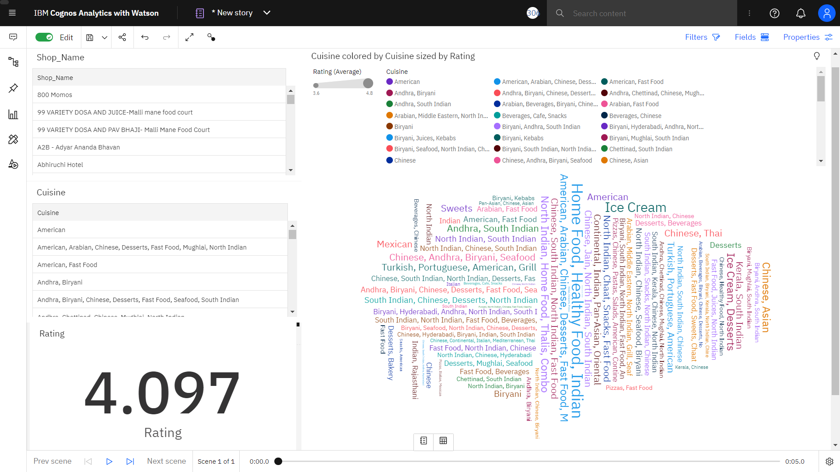

Slide 14
What is a scene?
A scene can be considered as a container for a sequence of objects, such as widgets, data, or animations. The objects in a scene are also placed into a timeline, which dictates when the objects appear in the scene.

Slide 15
What are animations?
Animations are one of the properties that a widget can have. By using animations, you can have define how widgets enter and exit your scenes.

Slide 16
How is a story different from a dashboard?
Stories are similar to dashboards because they also use visualizations to share your insights. Stories differ from dashboards because they provide an over-time narrative and can convey a conclusion or recommendation.
For example, each scene can contain an analysis, insight, or piece of information that is revealed as the viewer plays the scenes in the story. The scenes build upon each other until the final scene, which provides a conclusion or summary.

Slide 17
What can I use to assemble a story?
You can add the following to your scenes when creating a story:
Visualizations from your collection of pins
New visualizations from your data set
Text, media, web pages, images, and shapes

Slide 18

Conclusion

Slide 19




Thank you
Manay Rawal
Yash Raj Surana
https://www.ibm.com/products/cognos-analytics

